Slide 1
Makeup Style Transfer on Low-quality Images with Weighted Multi-scale Attention
Daniel Organisciak, Edmond S. L. Ho, Hubert P. H. Shum

Slide 2
Problems with State-of-the-Art
Stable
Not so stable
Outputs of Face Parsing Algorithm

Slide 3
Algorithm
Cycle-consistency Loss
(1)
(3)
(2)
(4)
Cycle-consistency Loss

Slide 4
Multi-scale Attention
$$A_{1}$$
$1×1$ conv
h
n
w
$$1×1$$
conv
$$A_{5}$$
$$A_{5}$$
$3×3$ conv
$$A_{3}$$
$$A_{3}$$
$$A_{3}$$
$$A_{1}$$
$${C_{1}×A}_{1}$$
h
h
$$×$$
$$×$$
h
w
w
w
$5×5$ conv
$$A_{5}$$
Squeeze
h
w
$$C_{1}$$
$$C_{3}$$
$$C_{5}$$
Excitation

Slide 5
Architectures
Generator
Discriminator
Encoder
Encoder Discriminator
Input
Attention
Convolutional Block
Conditional Instance Norm
Fully Connected Layer
Output

Slide 6
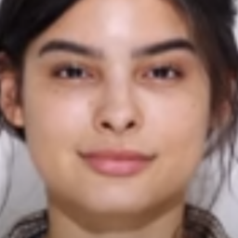
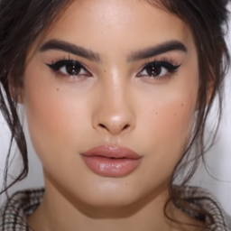
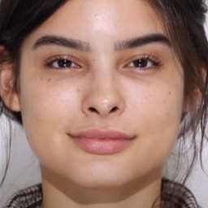
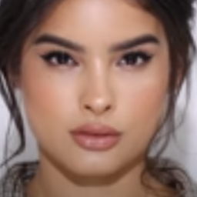
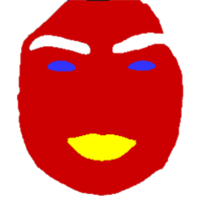
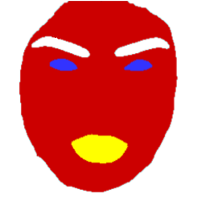
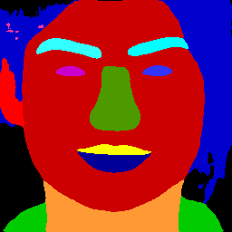
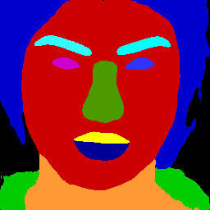
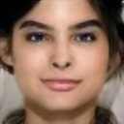
Quantitative Evaluation
Downsample then transfer makeup
Compute L1 distance between different face parts
a)
b)
c)

Slide 7
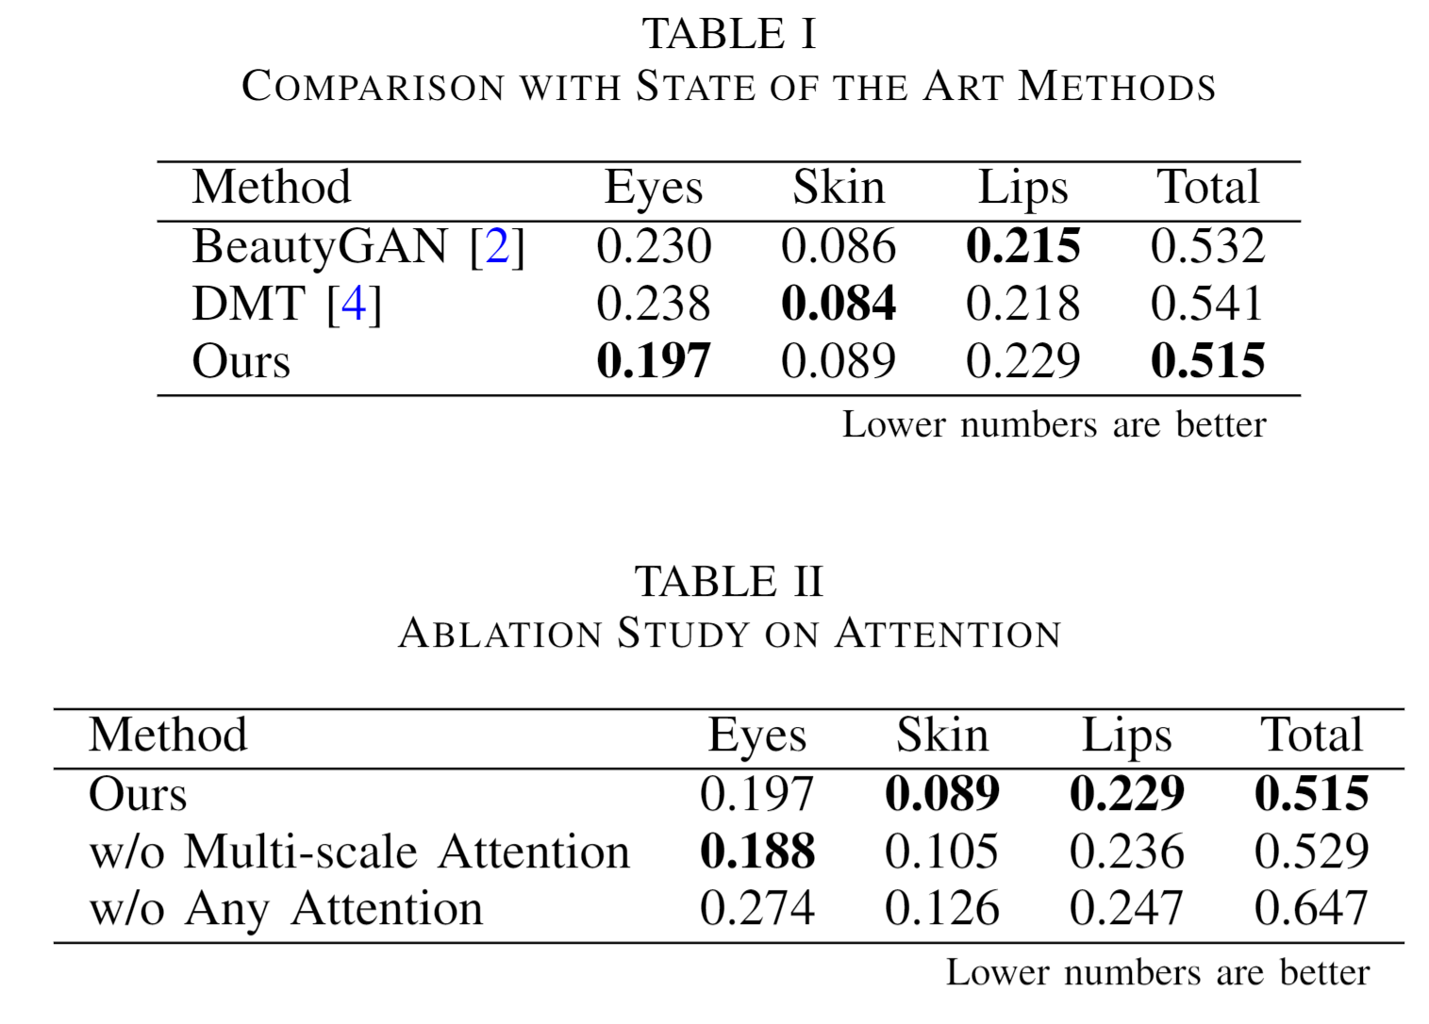
Quantitative Evaluation

Slide 8
Qualitative Evaluation
a)
Original
Ours
DMT
BeautyGAN
Ours
b)
Original
DMT
Ours
DMT
BeautyGAN
BeautyGAN

